Slide 1

Introductory Presentation on Khulna university of engineering and technology
Presented By:
Partho Choudhury Shoumya
Roll: 1807021
Dept. of Computer Science and Engineering
Khulna University of Engineering and Technology, Khulna

Slide 2
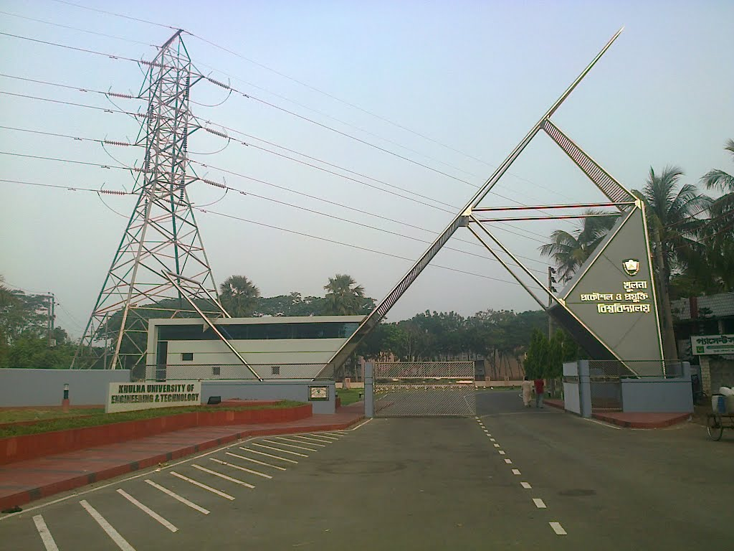
Agenda
Inception
History
Academic Details
Student Details
Residential Halls
Research
Facilities
Delicacy

Slide 3
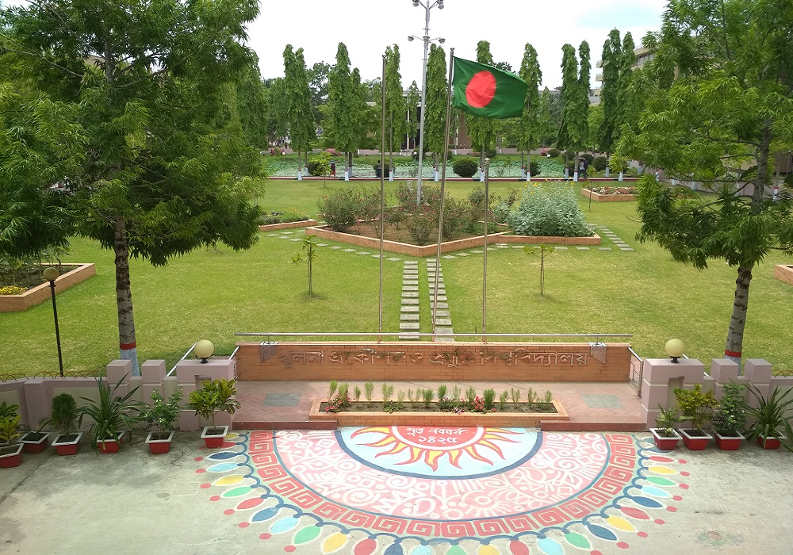
INception
Khunla Univerisity of Engineering and Technology is a prominent institution af Bangladesh dedicated to higher study on engineering and technology.
Established in 2003
Situated in southern city Khunla

Slide 4
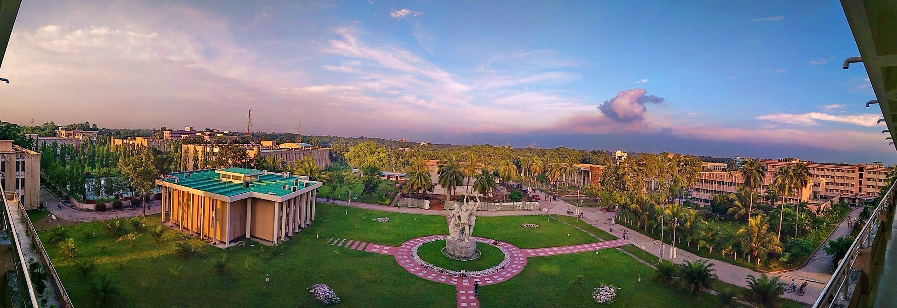
HISTORY OF KUET
Birth Story of KUET

Slide 5
TIMELINE
Upgraded and renamed as KUET
1974
Established as Khulna Engineering College
NOV 20XX
Disseminate standardized metrics
Became Bangladesh Institute of Technology (BIT), Khulna
MARCH 20XX
Foster holistically superior methodologies
2003
1986

Slide 6
ACADEMIC DETAILS
Descriptions of academic facilities

Slide 7
There are 3 faculties
Faculty of Civil Engineering
This faculty has 8 departments
CE
URP
BECM
Architecture
Physics
Chemistry
Math
Humanities
Faculty of Electrical and Electronic Engineering
This faculty has 5 departments
EEE
CSE
ECE
BME
MSE
Faculty of Mechanical Enineering
This faculty has 7 departments
ME
IEM
ESE
LE
TE
ChE
MTE
1
2
3

Slide 8
There are 20 Departments
1
2
3
4
5
Civil Engineering
Both UG and PG
Urban and Regional Planning
Both UG and PG
Building Engineering and Construction Management
UG only
Architecture
UG only
Physics
PG only
6
7
8
9
10
Chemistry
PG only
Mathematics
PG only
Humanities
Electrical and Electronic Engineering
Both UG and PG
Computer Science and Engineering
Both UG and PG
11
12
13
14
15
Electronics and Communication Engineering
Both UG and PG
Biomedical Engineering
Both UG and PG
Materials Science and Engineering
UG only
Mechanical Engineering
Both UG and PG
Industrial Engineering and Management
Both UG and PG
16
17
18
19
20
Energy Science and Engineering
Both UG and PG
Leather Engineering
Both UG and PG
Textile Engineering
UG only
Chemical Engineering
UG only
Mechatronics Engineering
UG only

Slide 9
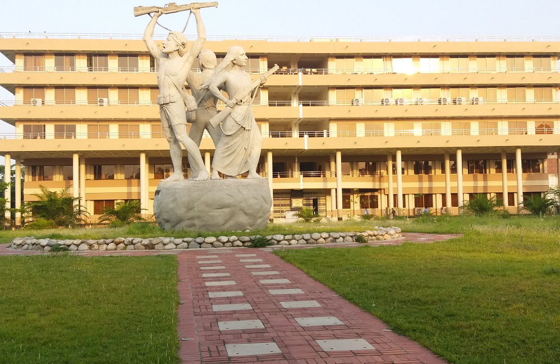
infrastructure
Academic building
Departments such as CE, ME etc. have academic buildings of their own.
Administrative building
The ‘DURBAR BANGLA’ premise

Slide 10
STUDENT DETAILS
Descriptions of students

Slide 11
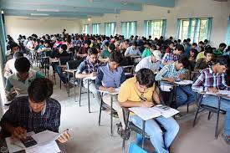
Students details
Almost 1000 students are admitted in those departments in undergraduate level each year
Modern technologically advanced classrooms
Well equipped laboratories
Highly qualified teacher panel.
Scholarships!!!

Slide 12
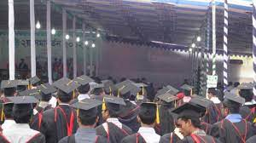
Success stories
Graduates get very good jobs in renowned companies as well as government sectors
Some become entrepreneur and find success
Lots of them choose to opt for higher study abroad
Graduates of KUET are highly skillful and they get highly appreciated for their merit in home and abroad.

Slide 13
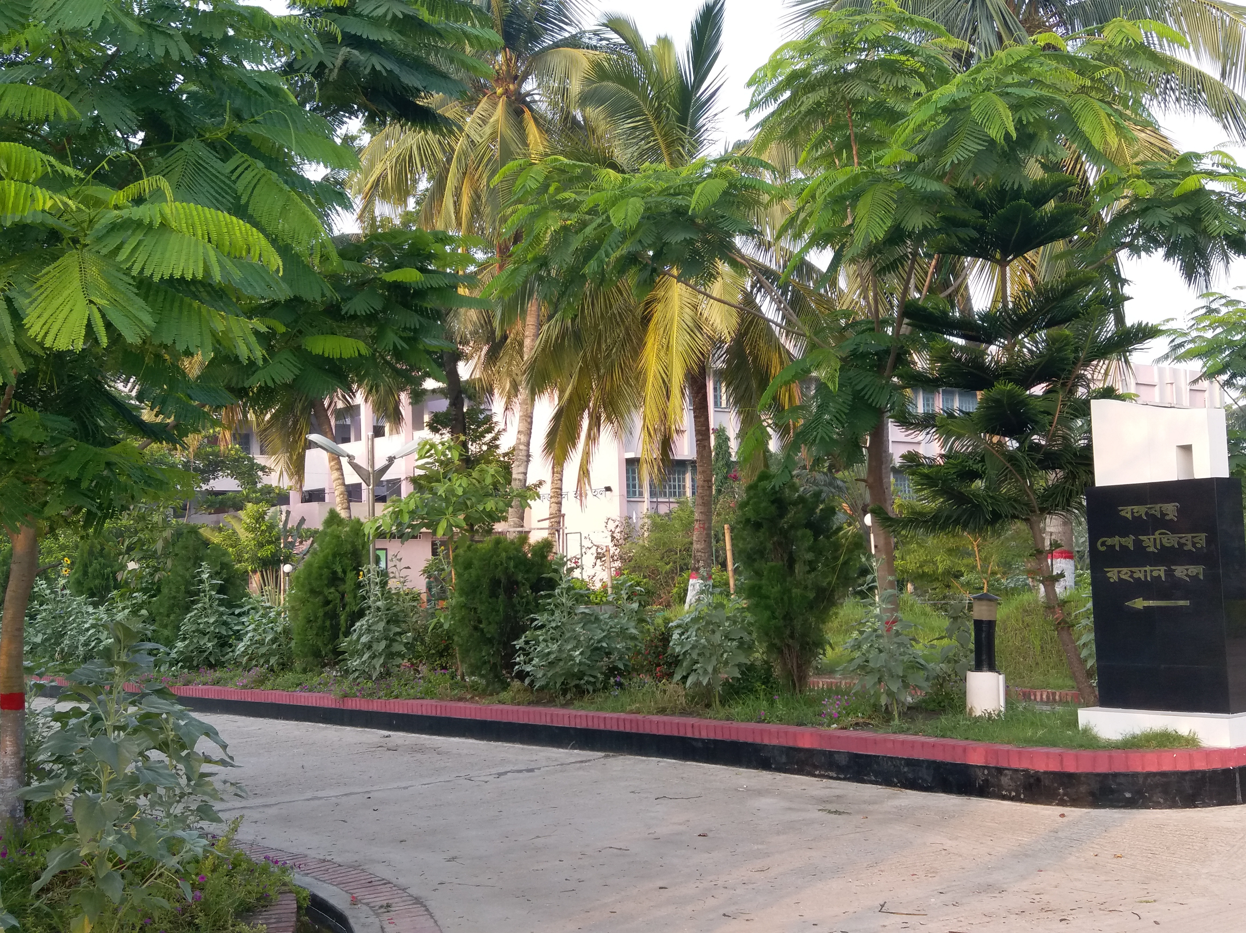
Residential Halls
Currently There are 7 residential Halls in Kuet for students and dorm for teachers.
6 for boys and 1 for girls.
Each hall has enough space for the allotted students.
Chairs, tables and bookshelves are given to students to help in their studies
Also, Each hall has:
Playground
Clean water supply
tv room
Hi-speed internet
Library etc.

Slide 14
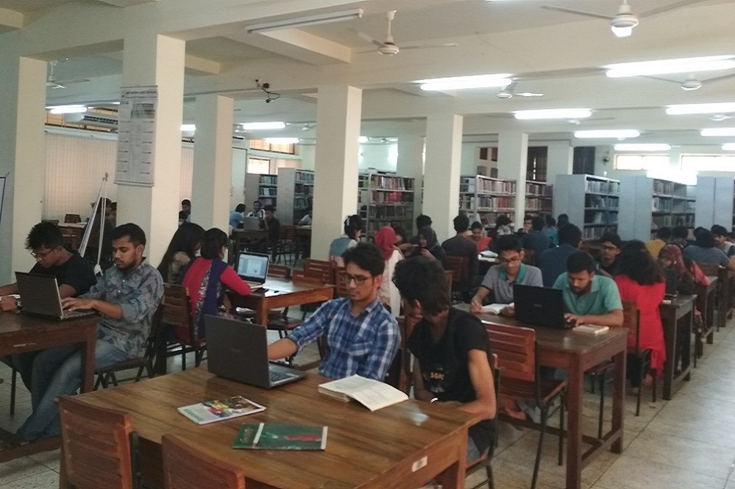
research
KUET emphasizes highly on research. There is a “Central Library” which is fully automatic, digital and contains lots of books and journals to help students and teachers in their research work.

Slide 15
FACILITIES
Facilities for Kuetians

Slide 16
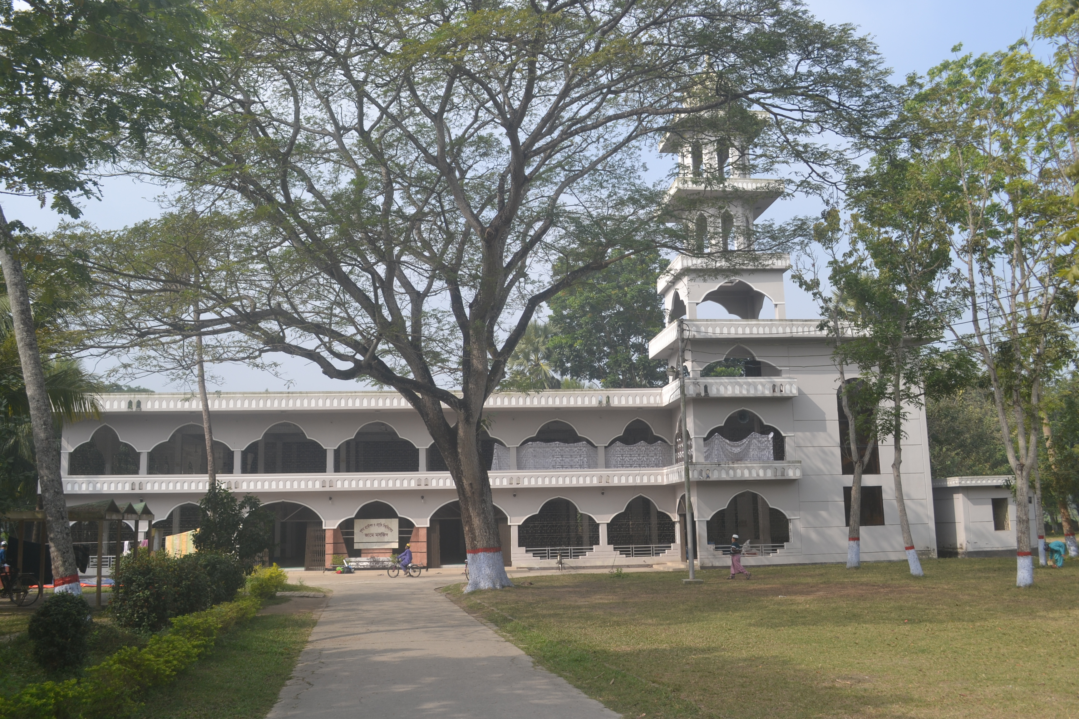
Central mosque
There is a well equipped central mosque in the university campus for the people to say their prayer.

Slide 17
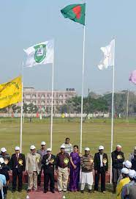
Central field
There is a huge ground in KUET where students play outdoor games in their free time. Also annual sports are held here. This ground helps students to by mentally and physically fit through the means of sports.

Slide 18
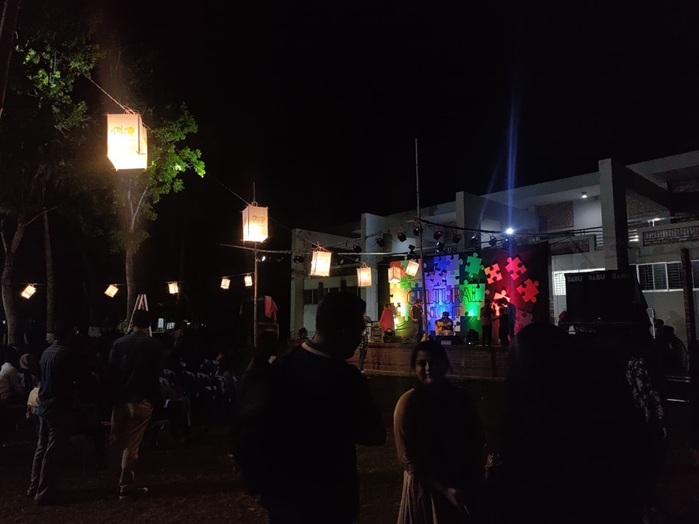
clubs
Try (Voluntary Social work club)
Dream (Voluntary blood donation club)
SGIPC (Programming Club)
Dhrupodi (Dance Club)
OKS (Sports club)
HACK (Hardware club)
Team Durbar (Mars rover club)
Math club etc.

Slide 19
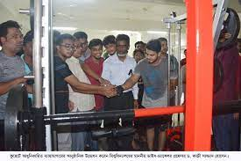
gym
Well equipped and fully functional gym is there to help students to keep their body fit

Slide 20
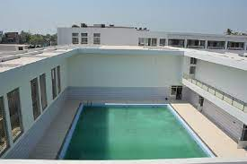
Swimming pool
Very nice, huge and beautiful swimming pool is there to entertain people.

Slide 21
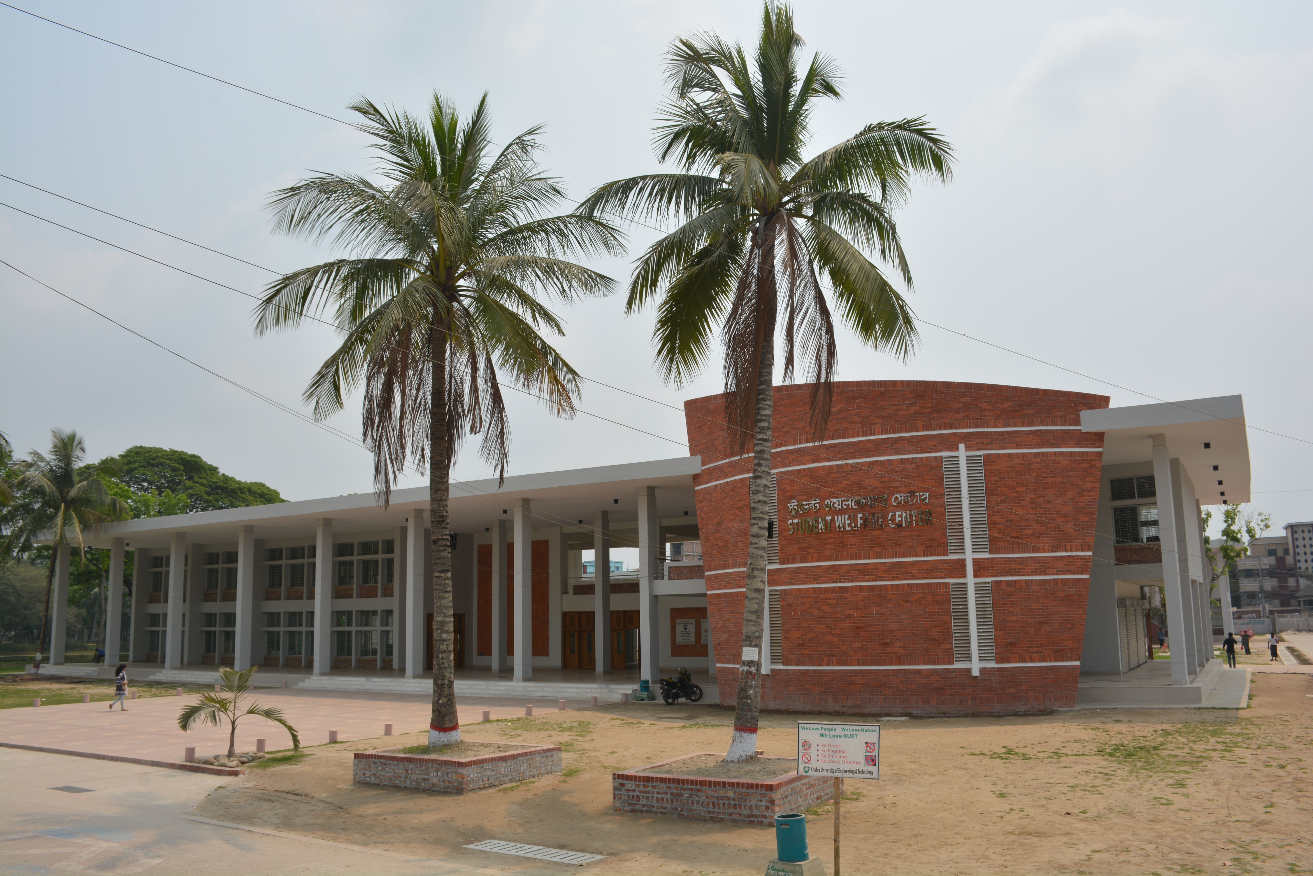
Student welfatre center
SWC is heart of the clubs activities in KUET. Musical events, Departmental nights, Dance fests etc. are held at SWC. Central cafeteria sells food in a reasonable price.

Slide 22
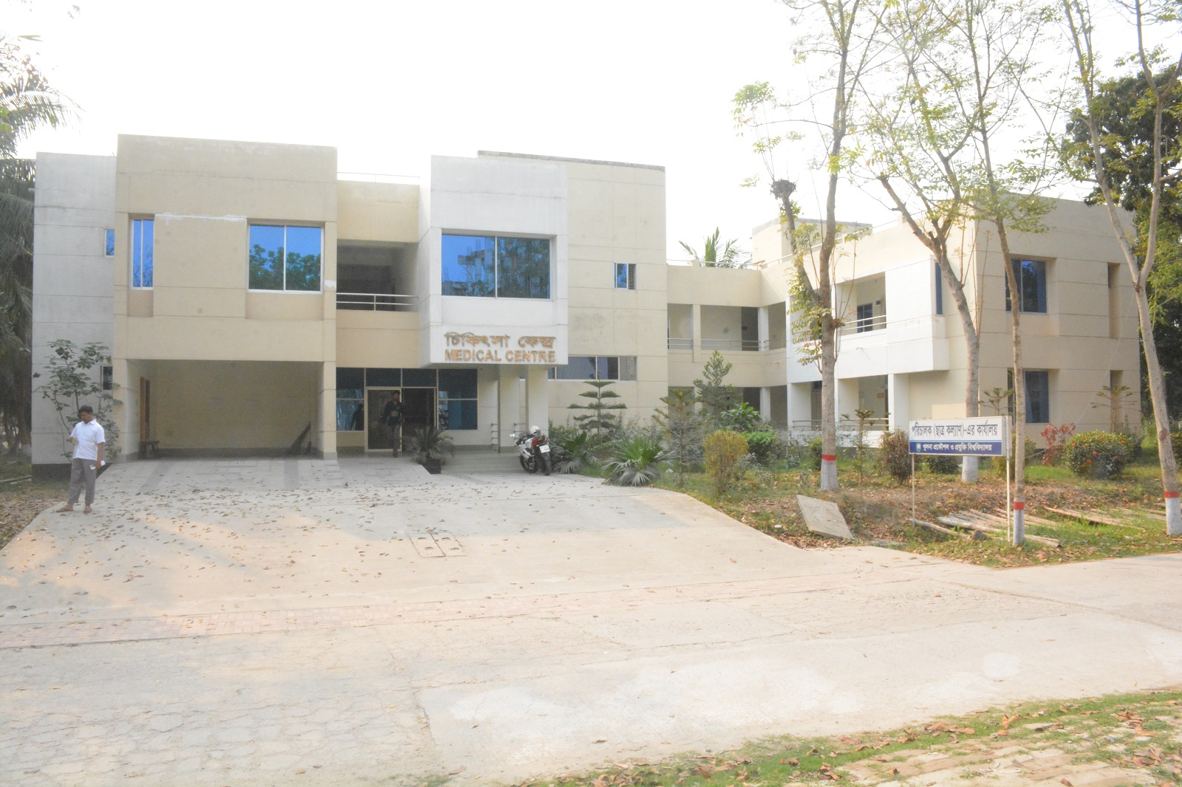
Medical Center
A well equipped and fully dedicated medical center of KUET takes good care of Kuetians. People can receive primary treatment and health support from here.

Slide 23
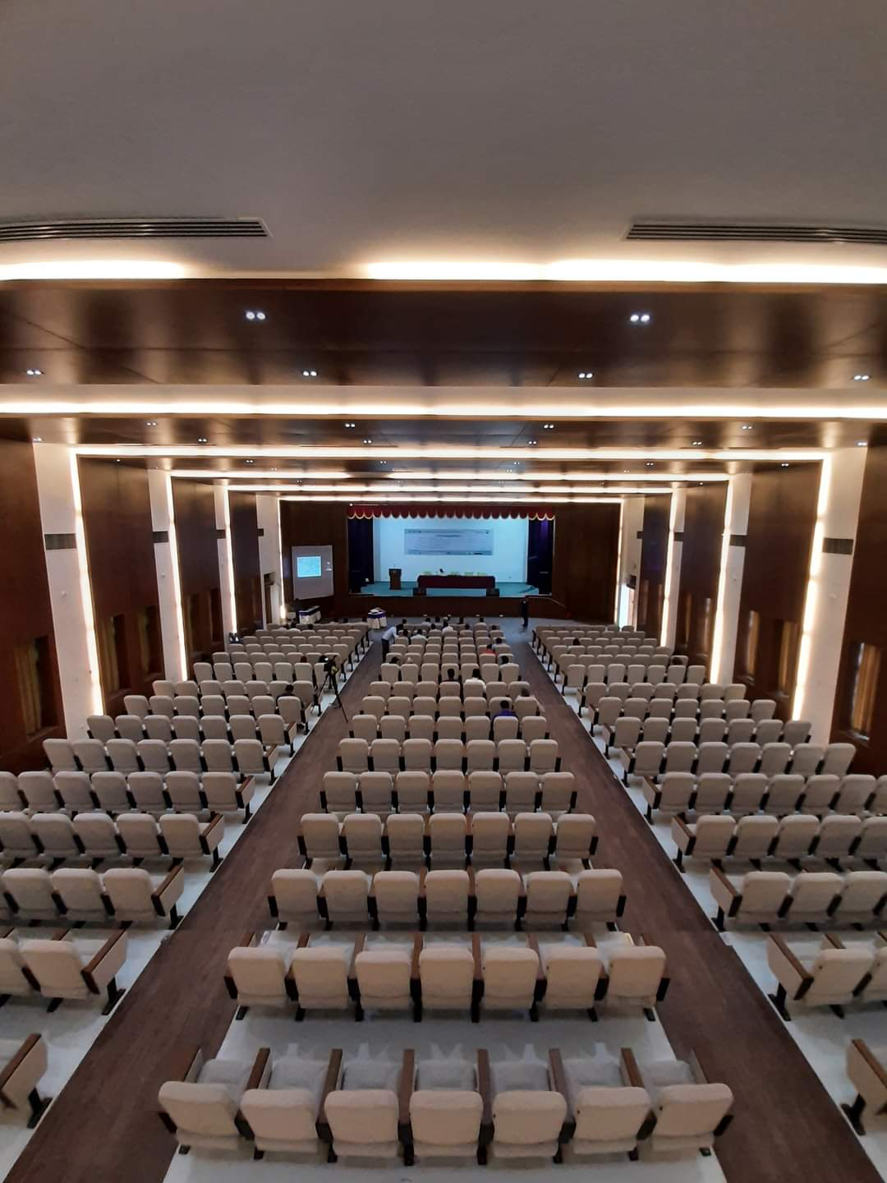
Auditorium
A nicely decorated and modern auditorium is exists in KUET which is used typically to host seminars, conferences and cultural events of the university.

Slide 24
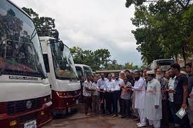
Transportation
There are lots of vehicles including bus, microbus, ambulance etc. which are used by students and teachers to travel from/to home, city regularly.

Slide 25
DELICACY OF KUET
Exclusivity of KUET

Slide 26
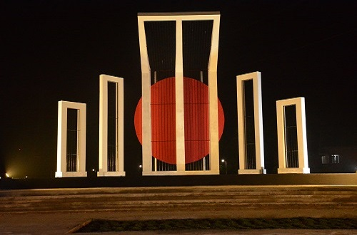
Shaheed minar
KUET has built Bangladesh’s 2nd largest shaheed minar to pay triubute to great martyrs of our independence of 1971.

Slide 27
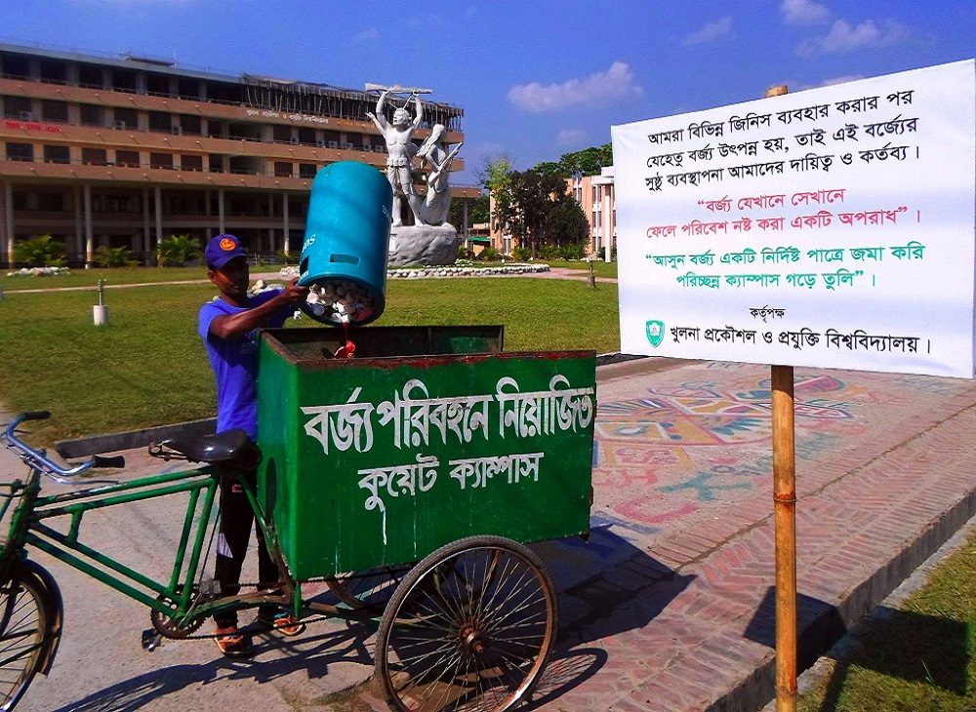
Clean campus
KUET has a GREEN, CLEAN and BEAUTIFUL campus of over 100 acres. People of KUET values highly of the cleanliness of the campus. There are lots of bins in all over the campus.

Slide 28
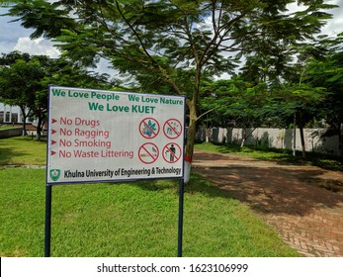
Safe campus
KUET has always been very much careful about the safety of its students and also the nature. The campus is free of any sort of drugs, ragging, smoking or waste littering.

Slide 29
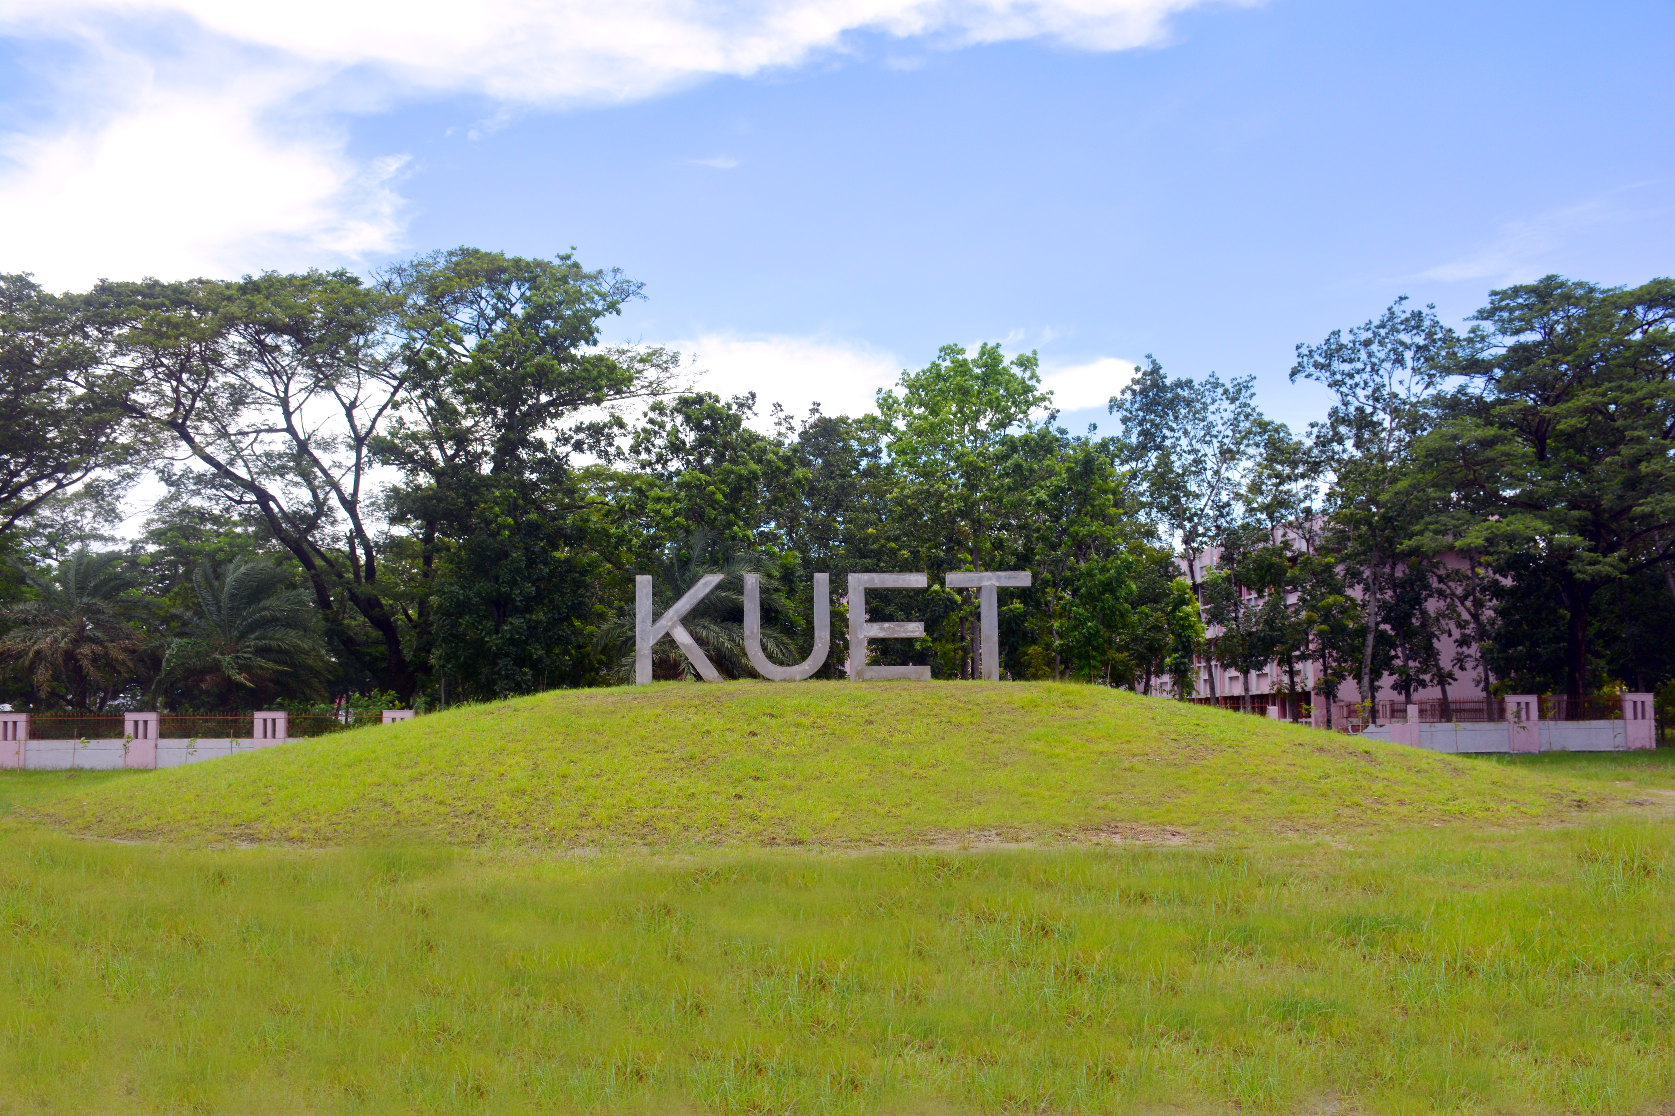
conclusion
Very beautiful campus
Highly qualified teacher panel
Lots of facilities for study and research
One of the topmost institution
Endless opportunity awaits

Slide 30
Thank you
Partho Choudhury Shoumya
1807021

